Slide 1

ELD411
Mid-Term Review — 2026
Autonomous robotic manipulator for AMR sampling (Petri Dish)
Arnav Panjla 2023EE10978
Manashvi Garg 2023EE1141

Slide 2
Problem statement
  Antimicrobial resistance (AMR) requires continuous surveillance.
  Rural/village-level sampling can generate many biological samples.
  Samples need to be collected, transported, incubated/processed and analyzed.
  Manual Petri-dish handling becomes a bottleneck as sample volume increases.
Can a robotic manipulator autonomously handle Petri dishes and perform repetitive laboratory operations required for AMR sampling?

Slide 3
Market / System Scale Analysis
Estimating the Sampling Scale
  Village population: ~100 people
  Estimated sampling fraction: 2–5% → 2–5 samples/village
  Collection capacity: 4–5 field collectors
  Villages visited per collector: ~5–6 villages/day
  Design target: approximately 100 Petri dishes/day
Processing Time Creates a Capacity Requirement
  Target incoming throughput: ~100 dishes/day
  Approximate processing/observation duration: 5–6 days
  Multiple daily batches are therefore simultaneously inside the laboratory pipeline.
  Required in-process capacity:
  100 dishes/day×5−6 days≈500−600
  Design capacity target: ~600 Petri dishes

Slide 4
Hardware Architecture

Slide 5
Manipulator Selection

Slide 6
Computer Vision Pipeline & setup

Slide 7
Gazebo Simulation

Slide 8
Autonomous Pick-and-Place

Slide 9
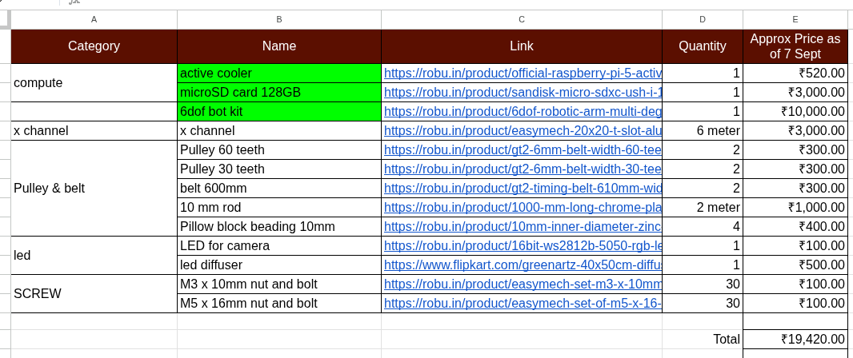
Bill of Materials & Procurement

Slide 10
Current Progress & Roadmap
MID-TERM STATUS
NEXT PHASE ROADMAP
Problem & system definition
COMPLETED
01
Finalize manipulator
Procurement + end-effector integration
Hardware architecture
COMPLETED
Complete perception
02
Dish localization + feature detection
Raspberry Pi + camera
COMPLETED
03
Implement robot control
Computer vision pipeline
IN PROGRESS
ESP32 / Zephyr + motor interface
04
Validate in Gazebo
ESP32 + Zephyr RTOS
IN PROGRESS
ROS 2 + trajectories + pick/place
Manipulator procurement
IN PROGRESS
05
System integration
Vision → coordinates → manipulation
Gazebo simulation
IN PROGRESS
Throughput testing
06
Target: ~100 dishes/day
Autonomous pick & place
UPCOMING

Slide 11
THANK YOU

